Slide 1
UNIT-V
Code Generation:
Issues in the Design of a Code Generator,
The Target Language,
Addresses in the Target Code Basic Blocks and Flow Graphs.
Code Optimization:
Optimization of Basic Blocks.
Peephole Optimization,
Register Allocation and Assignment,
Machine Independent Optimizations
The Principal Sources of Optimizations,
Introduction to data flow analysis.

Slide 2
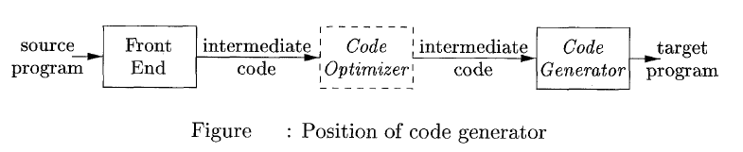
Code Generation
The final phase in our compiler model is the code generator. It takes as input the intermediate representation (IR) produced by the front end of the compiler, along with relevant symbol table information, and produces as output a semantically equivalent target program

Slide 3
The requirements are :The target program must make effective use of the available resources of the target machine and run efficiently.
The challenge is : mathematically, the problem of generating an optimal target program for a given source program is undecidable.
The designed code generator can produce code that is several times faster than code produced by a naive one.
Compilers that need to produce efficient target programs, include an optimization phase prior to code generation.
The optimizer maps the IR into IR from which more efficient code can be generated.
The code optimization and code-generation phases of a compiler, often referred to as the back end, may make multiple passes over the IR before generating the target program.

Slide 4
5.1 Issues in the Design of a Code Generator
While the details are dependent on the target language and the operating system, issues such as memory management, instruction selection, register allocation, and evaluation order are inherent in almost all code generation problems

Slide 5
5.1.1 Input to the Code Generator
The input to the code generator is the intermediate representation of the source program produced by the front end, together with information in the symbol table that is used to determine the run time addresses of the data objects denoted by the names in the intermediate representation(IR).
IR includes:
- linear representations such as postfix notation,
- three address representations such as quadruples, triples, ...
- virtual machine representations such as byte code, stack m/c....
- graphical representation as syntax trees and dags.

Slide 6
Prior to code generation the front end has scanned, parsed, and translated the source program into a reasonably detailed intermediate representation.
The values of names appearing in the intermediate language can be represented by quantities that the target machine can directly manipulate (bits, integers, reals, pointers, etc.).
The necessary type checking has take place, so type conversion operators have been inserted wherever necessary and obvious semantic errors (e.g., attempting to index an array by a floating point number) have already been detected.
The code generation phase can therefore proceed on the assumption that its input is free of errors.
Some compilers, this kind of semantic checking is done together with code generation .

Slide 7
5.1.2.TARGET PROGRAMS
The output of the code generator is the target program.
The output may take on a variety of forms:
absolute machine language, relocatable machine language, or assembly language.
The most common target-machine architectures are RISC (reduced instruction set computer), CISC (complex instruction set computer), and stack based.
Producing an absolute machine language program as output has the advantage that it can be placed in a location in memory and immediately executed.
A small program can be compiled and executed quickly.

Slide 8
Producing a relocatable machine language program as output allows subprograms to be compiled separately.
A set of relocatable object modules can be linked together and loaded for execution by a linking loader.
If the target machine does not handle relocation automatically, the compiler must provide explicit relocation information to the loader to link the separately compiled program segments

Slide 9
5.13 INSTRUCTION SELECTION
The complexity of mapping IR program into code-sequence for target machine depends on
- level of IR (high level or low level)
- nature of instruction set (data type support)
- desired quality of generated code(speed and size)
Instruction speeds and machine idioms are other important factors..

Slide 10
For each type of three- address statement we can design a code skeleton that outlines the target code to be generated for that construct.
For example, every three address statement of the form x := y + z, where x, y, and z are statically allocated, can be translated into the code sequence
MOV y, R0 /* load y into register R0 */
ADD z, R0 /* add z to R0 */
MOV R0, x /* store R0 into x */

Slide 11
Unfortunately, this kind of statement – by statement code generation often produces poor code.
For example, the sequence of statements
a := b + c
d := a + e would be translated into
1. MOV b, R0
2. ADD c, R0
3. MOV R0, a // Here 4th stmt is redundant since
4. MOV a, R0 //it loads a value that stored
5. ADD e, R0
6. MOV R0, d

Slide 12
The quality of the generated code is determined by its speed and size.
A target machine with a rich instruction set may provide several ways of implementing a given operation.
Since the cost differences between different implementations may be significant, a naive translation of the intermediate code may lead to correct, but unacceptably inefficient target code.

Slide 13
For example, if the target machine has an "increment" instruction (INC), then the three-address statement a = a + 1 may be implemented more efficiently by the single instruction INC a, rather than by a more obvious sequence that loads a into a register, add one to the register, and then stores the result back into a.
MOV a, R0
ADD #1,R0
MOV R0, a

Slide 14
5.1.4 Register Allocation
Instructions involving register operands are usually shorter and faster than those involving operands in memory.
Efficient utilization of register is particularly important in generating good code.
The use of registers is often subdivided into two subproblems:
1. During Register allocation, we select the set of variables that will reside in registers at a point in the program.
2. During a subsequent Register assignment phase, we pick the specific register that a variable will reside in.

Slide 15
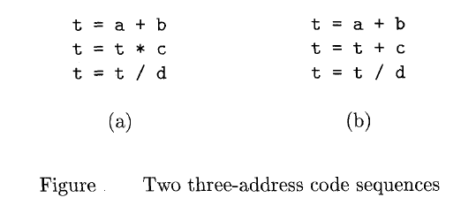
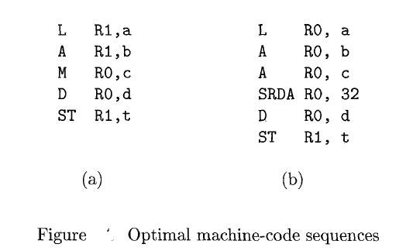
The two three-address code sequences in Fig in which the only difference in (a) and (b) is the operator in the second statement.
The shortest assembly-code sequences for (a) and (b).
SRDA stands for Shift-Right-Double-Arithmetic and SRDA R0,32 shifts the dividend into R1 and clears RO so all bits equal its sign bit.
L, ST, and A stand for load, store, and add, respectively.
The optimal choice for the register into which a is to be loaded depends on what will ultimately happen to t.

Slide 16
5.1.5 Evaluation Order
The order in which computations are performed can affect the efficiency of the target code.
Picking a best order is another difficult, NP-complete problem.
Some orders require fewer registers than others

Slide 17
5.2 The Target Language
The goal is to be simple but to permit the study of nontrivial addressing modes and the corresponding optimizations. A charging scheme is instituted to reflect that complex addressing modes are not free.
5.2.1: A Simple Target Machine Model
Load:
LD dest, addr loads the value in location addr into location dest.
LD r,x which loads the value in location x into register r
LD reg1, reg2 is a register to register copy.
ST x,r Stores the value in register r into location x
Computational Operators:
Op dest, src1.src2 op is operator like ADD, SUB,...
dest, src1, src2 are distinct values
SUB r1,r2,r3 computes r1=r2-r3

Slide 18
Unconditional Jump:
BR L causes control to branch(BR) to the machine instruction with label L
Conditional Jumps:
Bcond r, L where r is a register and L is a label, cond stands for any common test on values in the register
Addressing modes:
Variable names x referring to the memory location that is reserved for x.
a(R2) a is a variable and R2 is register
Rl = contents (a + contents (R2))
Eg: LD R1, 100(R2) has the effect of setting
R1 = contents(100 + contents(R2)),i.,e of loading into R1 the value in the memory location obtained by adding 100 to the contents of register R2

Slide 19
The three-address statement x = y - z can be implemented by the machine instructions:
LD R1, y // R1 = y
LD R2, z // R2 = z
SUB R1, R1, R2 // R1 = R1 - R2
ST x, R1 // x = R1
a is an array whose elements are 8-byte values, perhaps real numbers. Elements of a are indexed starting at 0.
Execution of three-address instruction b = a [i] by the machine instructions
LD R1, i // R1 = i
MUL R1, R1, 8 // R1 = Rl * 8
LD R2, a(R1) // R2 = contents(a + contents(R1))
ST b, R2 // b = R2

Slide 20
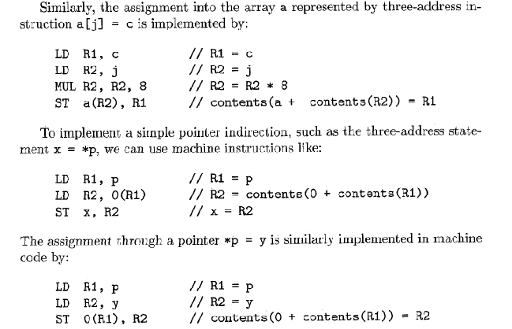

Slide 21
Three-address instruction like If x<y got L
The machine-code equivalent would be something like:
LD R1, x // R1 = x
LD R2, y // R2 = y
SUB R1, R1, R2 // R1 = R1 - R2
BLTZ R1, M // i f R1 < 0 jump t o M
M is the label that represents the first machine instruction generated from the three-address instruction that has label L.

Slide 22
5.2.2 Program and Instruction Costs
Cost of instruction = 1+ cost of operands
Cost of register operand =0
Cost involving memory & constant =1
Cost of a program = sum of instruction cost
Eg:
The instruction LD R0, R1 copies the contents of register R1 into register R. This instruction has a cost of one because no additional memory words are required.
The instruction LD Ro, M loads the contents of memory location M into register R0. The cost is two since the address of memory location M is in the word following the instruction.
The instruction LD R1, *100(R2) loads into register R1 the value given by contents(contents(l00 + contents(R2))). The cost is three because the constant 100 is stored in the word following the instruction

Slide 23
5.3 Addresses in the Target Code
There are 4 possibilities for addresses that must be generated depending on which of the following areas the address refers to.
The text or code area. The location of items in this area is statically determined, i.e., is known at compile time.
The static area holding global constants. The location of items in this area is statically determined.
The stack holding activation records. The location of items in this area is not known at compile time.
The heap. The location of items in this area is not known at compile time.

Slide 24
5.3.1: Static Allocation
Three-address statements are:
call callee
return
h a l t
act ion, which is a placeholder for other three-address statements.
With static allocation we know before execution where all the data will be stored.
There are no recursive procedures, there is no run-time stack of activation records.
Instead the ARs (one per procedure) are statically allocated by the compiler.

Slide 25
Caller Calling Callee
In this simplified situation, calling a parameterless procedure just uses static addresses and can be implemented by two instructions. Specifically, call procA can be implemented by
ST callee.staticArea, #here+20
BR callee.codeArea
The return address is the first location in the activation record (in general, for a parameterless procedure, the return address would be a fixed offset from the beginning of the AR). The attribute staticArea for the address of the AR for the given procedure (remember again that there is no stack and no heap).
#here+20 is , # is an immediate constant represent the address of the current instruction (the compiler knows this value since we are assuming that the entire program, i.e., all procedures, are compiled at once). The two instructions listed contain 3 constants, which means that the entire sequence takes 5 words or 20 bytes. Thus here+20 is the address of the instruction after the BR, which is indeed the return address.

Slide 26
Callee Returning
With static allocation, the compiler knows the address of the AR for the callee and the return address is the first entry. Then a procedure return is simply BR *callee.staticArea
The indirect addressing is value callee.staticArea is the address of a memory location into which the caller placed the return address. The branch is not to callee.staticArea, but instead to the return address, which is the value contained in callee.staticArea.

Slide 27
Consider a main program calling a procedure P and then halting. Other actions by Main and P are indicated by subscripted uses of ”other”.
// Quadruples of Main
other₁
call P
other₂
halt
// Quadruples of P
other₃
return
Let us arbitrarily assume that the code for Main starts in location 1000 and the code for P starts in location 2000 (there might be other procedures in between). Also assume that each other_{i} requires 100 bytes (all addresses are in bytes).
Finally, we assume that the ARs for Main and P begin at 3000 and 4000 respectively. Then the following machine code results.

Slide 28
// Code for Main
1000: Other₁
1100: ST 4000, #1120 // P.staticArea, #here+20
1112: BR 2000 // Two constants in previous instruction take 8 bytes
1120: other₂ 1220: HALT
...
// Code for P
2000: other₃
2100: BR *4000
...
// AR for Main
3000: // Return address stored here (not used)
3004: // Local data for Main starts here
...
// AR for P
4000: // Return address stored here
4004: // Local data for P starts here

Slide 29
5.3.2 Stack Allocation
The key distinction is that the location of the current AR is not known at compile time. Instead a pointer to the stack must be maintained dynamically.
Dedicate a register, call it SP, where SP point to the bottom of the current AR, that is the entire AR is above the SP..
The main procedure (or the run-time library code called before any user-written procedure) must initialize SP with LD SP, #stackStart where stackStart is a known-at-compile-time constant.
The caller increments SP (which now points to the beginning of its AR) to point to the beginning of the callee's AR. This requires an increment by the size of the caller's AR, which of course the caller knows.
The only part that is not known at compile time is the size of the dynamic arrays..

Slide 30
Caller Calling Callee
The code generated for a parameterless call is
ADD SP, SP, #caller.ARSize
ST 0(SP), #here+16 // save return address
BR callee.codeArea
Callee Returning
The return requires code from both the Caller and Callee. The callee transfers control back to the caller with BR *0(SP) Upon return the caller restore the stack pointer with SUB SP, SP, caller.ARSize

Slide 31
We again consider a main program calling a procedure P and then halting. Other actions by Main and P are indicated by subscripted uses of `other'.
// Quadruples of Main
other₁
call P
other₂
halt
// Quadruples of P
other₃
return

Slide 32
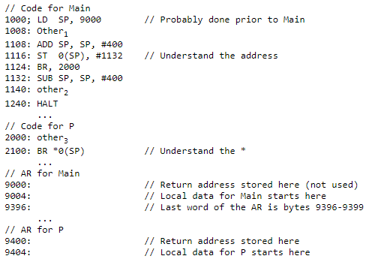
Recall our assumptions that the code for Main starts in location 1000, the code for P starts in location 2000, and each other_{i} requires 100 bytes. Let us assume the stack begins at 9000 (and grows to larger addresses) and that the AR for Main is of size 400 (we don't need P.ARSize since P doesn't call any procedures). Then the following machine code results.

Slide 33
5.3.3 Run-Time Addresses for Names
The storage-allocation strategy and the layout of local data in an activation record for a procedure determine how the storage for names is accessed

Slide 34
5.4 Basic Blocks and Flow Graphs
Basic Blocks
A basic block is a sequence of consecutive statements in which flow of control enters at the beginning and leaves at the end without any halt or possibility of branching except at the end. The basic blocks do not have any in and out branches except entry and exit.
The first task is to partition a set of three-address code into the basic block. The new basic block always starts from the first instruction and keep adding instructions until a jump or a label is met. If no jumps or labels are found, the control will flow in sequence from one instruction to another.
The following sequence of three-address statements forms a basic block
t1 : = a * a
t2 : = a * b
t3 : = 2 * t2
t4 : = t1 + t3
t5 : = b * b
t6 : = t4 + t5

Slide 35
Basic Block Construction:
Algorithm: Partition three-address code into basic blocks
Input: The input for the basic blocks will be a sequence of three-address code.
Output: The output is a list of basic blocks with each three address statements in exactly one block.
METHOD:
First, we will identify the leaders in the intermediate code.
Rules for finding leaders:
1)The first instruction in the intermediate code will always be a leader.
2) Any instruction that is the target of a conditional or unconditional jump is a leader.
3.)Any instruction that immediately follows a conditional or unconditional jump is a leader.
For each leader, its basic block consists of the leader and all statements up to but not including the next leader or the end of the program.

Slide 36
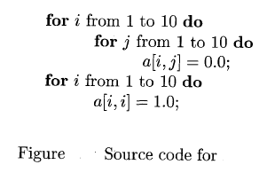
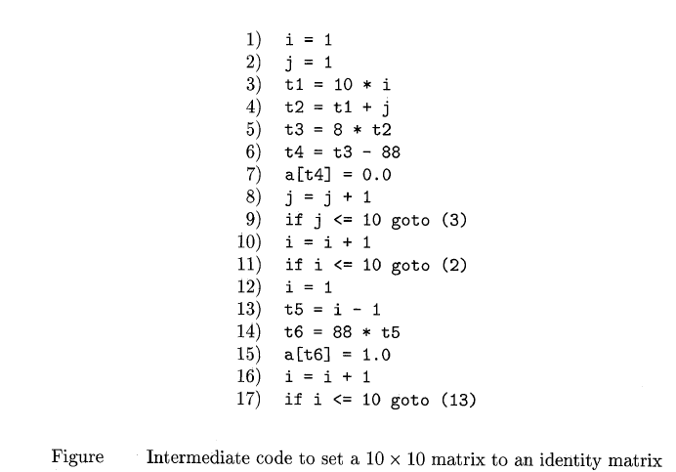

Slide 37
First, instruction 1 is a leader by rule (I)
Find the jumps. In this example, there are three
jumps, all conditional, at instructions 9, 11, and 17. By rule (2), the targets of these jumps are leaders; they are instructions 3, 2, and 13, respectively.
By rule (3), each instruction following a jump is a leader; those are instructions 10 and 12.
Note that no instruction follows 17 in this code, but if there were code following, the 18th instruction would also be a leader.
The leaders are instructions 1, 2, 3, 10, 12, and 13. The basic block of each leader contains all the instructions from itself until just before the next leader. Thus, the basic block of 1 is just 1, for leader 2 the block is just 2. Leader 3, however, has a basic block consisting of instructions 3 through 9, inclusive. Instruction 10's block is 10 and 11; instruction 12's block is just 12, and instruction 13's block is 13 through 17.

Slide 38
Flow Graphs
Intermediate-code program is partitioned into basic blocks, then represent the flow of control between them by a flow graph.
There is an edge from block B to block C if and only if it is possible for the first instruction in block C to immediately follow the last instruction in block B.
Two ways that such an edge could be justified:
1. There is a conditional or unconditional jump from the end of B to the beginning of C.
2. C immediately follows B in the original order of the three-address instructions, and B does not end in an unconditional jump.
We say that B is a predecessor of C, and C is a successor of B.

Slide 39
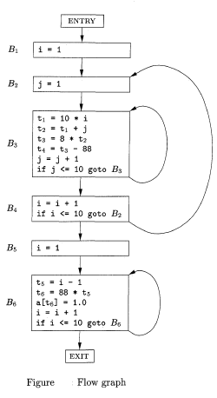
The leaders are instructions 1, 2, 3, 10, 12, and 13

Slide 40
Code Optimization

Slide 41
5.5 Optimization of Basic Blocks
5.5.1 The DAG Representation of Basic Blocks
Construct a DAG for a basic block as follows:
1. There is a node in the DAG for each of the initial values of the variables appearing in the basic block.
2. There is a node N associated with each statement s within the block. The children of N are those nodes corresponding to statements that are the last definitions, prior to s, of the operands used by s.
3. Node N is labeled by the operator applied at s, and also attached to N is the list of variables for which it is the last definition within the block.
4. Certain nodes are designated output nodes. These are the nodes whose variables are live on exit from the block; that is, their values may be used later, in another block of the flow graph. Calculation of these "live variables" is a matter for global flow analysis

Slide 42
Code improving transformations on the code represented by the block:
a) We can eliminate local common sub expressions, like, instructions that compute a value that has already been computed.
b) We can eliminate dead code, that is, instructions that compute a value that is never used.
c) We can reorder statements that do not depend on one another; such reordering may reduce the time a temporary value needs to be preserved in a register.
d) We can apply algebraic laws to reorder operands of three-address instructions, and sometimes thereby simplify the computation.

Slide 43
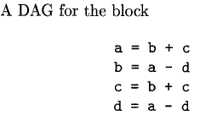
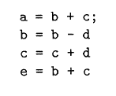
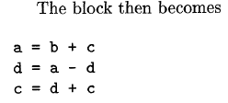
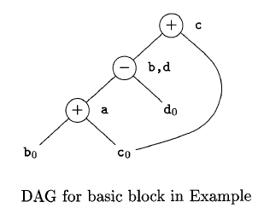
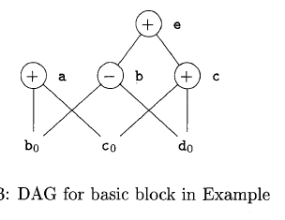
5.5.2 Finding Local Common Subexpressions

Slide 44
5.5.3 Dead Code Elimination
The operation on DAG's that corresponds to dead-code elimination can be implemented as :
Delete from a DAG any root (node with no ancestors) that has no live variables attached.
Repeated application of this transformation will remove all nodes from the DAG that correspond to dead code.
Examples:
– No control flows into a basic block
– A variable is dead at a point -> its value is not used
anywhere in the program
– An assignment is dead -> assignment assigns a value to a
dead variable

Slide 45
Examples:
i=j;
…
X=i+10
....
The optimization can be performed by
Eliminating the assignment statement i=j
This assignment statement is called dead
assignment .

Slide 46
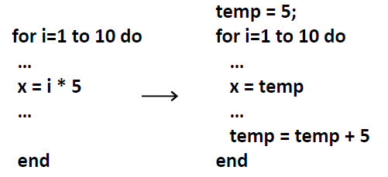
5.5.4 The Use of Algebraic Identities
Algebraic identities to eliminate computations
X+0=0+X=X
X*1=1*X=X
X-0=X
X/1=X
Reduction in Strength: Replacing expensive operators by cheaper ones
Expensive Cheaper
x² X*X
2*X X+X
X/2 X*0.5
Constant folding : evaluate constant expression and replace it by their values 2+3 is written as 5

Slide 47
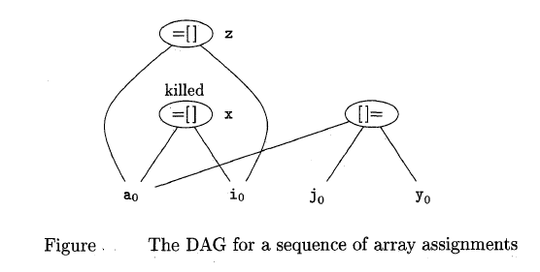

5.5.5 Representation of Array References
The proper way to represent array accesses in a DAG is as follows:
1. An assignment from an array, like x = a[i] , is represented by creating a node with operator =[] and two children representing the initial value of the array, a0 in this case, and the index i. Variable x becomes a label of this new node.
2. An assignment to an array, like a[jl = y, is represented by a new node with operator [] = and three children representing a0, j and y. There is no variable labeling this node.

Slide 48
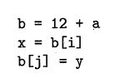
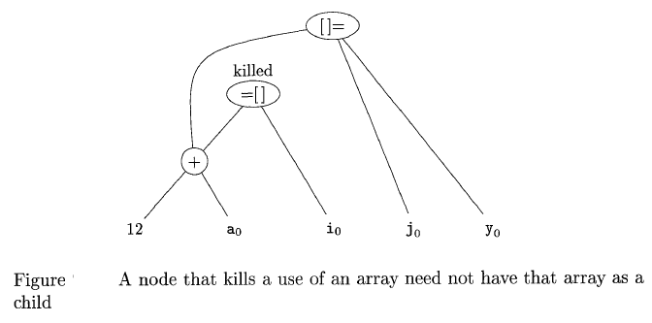

Slide 49
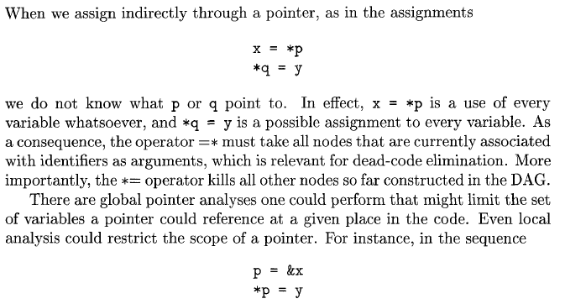
5.5.6 Pointer Assignments and Procedure Calls

Slide 50
5.6 Peephole Optimization
A simple but effective technique for locally improving the target code is peephole optimization, which is done by examining a sliding window of target instructions (called the peephole) and replacing instruction sequences within the peephole by a shorter or faster sequence.
Peephole optimization can also be applied directly after intermediate code generation to improve the intermediate representation.
Characteristic of Peephole optimization
Redundant-instruction elimination
Flow-of-control optimizations
Algebraic simplifications
Use of machine idioms

Slide 51
5.6.1 Eliminating Redundant Loads and Stores
LD a, RO
ST RO, a
If we see the instruction sequence in a target program, we can delete the store instruction because whenever it is executed, the first instruction will ensure that the value of a has already been loaded into register RO.
If the store instruction had a label, we could not be sure that the first instruction is always executed before the second, so we could not remove the store instruction.

Slide 52
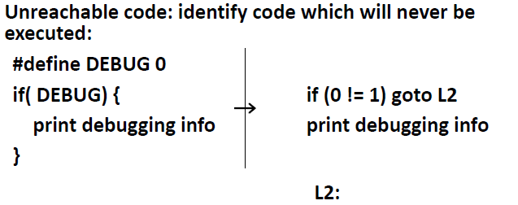
5.6.2 Eliminating Unreachable Code

Slide 53
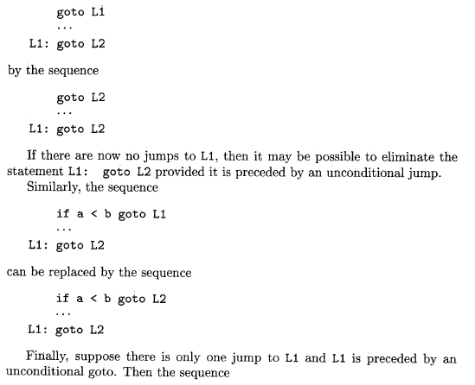
5.6.3 Flow-of-Control Optimizations

Slide 54
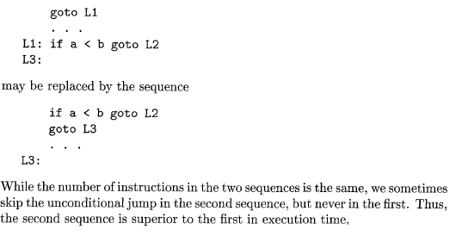

Slide 55
5.6.4 Algebraic Simplification and Reduction in Strength
These algebraic identities can also be used by a peephole optimizer to eliminate three-address statements such as in the peephole.
X=X+0 or X= X*1
The target machine may have hardware‘ instructions to implement certain specific operations efficiently. Detecting situations that permit the use of these instructions can reduce execution time significantly. For example, some machines have auto-increment and auto-decrement addressing modes.
These add or subtract one from an operand before or after using its value. The use of the modes greatly improves the quality of code when pushing or popping a stack, as in parameter passing. These modes can also be used in code for statements like x=x+l.
5.6.5 Use of Machine Idioms

Slide 56
5.7 Register Allocation and Assignment
Instructions involving register operands are usually shorter and faster than those involving operands in memory.
One approach to register allocation and assignment is to assign specific values in the target program to certain register
Eg: Assign base address to one group of registers , arithmetic computations to another top of stack to a fixed registers so on.
Adv: It simplifies design of code generation
DisAdv: It uses registers inefficiently

Slide 57
5.7.1 Global Register Allocation
Strategies:
Assign Registers to frequently used values through a loop
One strategy for global register allocation is to assign some fixed number of registers to hold most active values in each inner loop
The selected values may be different in different loops
Registers not already allocated may be used to hold values local to one block
Adv: simple to implement
Disadva: Fixed number of registers is not always the right number to make available for global register allocation

Slide 58

5.7.2 Usage Counts
The usage count is the count for the use of some variable x in some register used in any basic block
The usage count gives the idea about how many units of cost can be saved by selecting a specific variable for global register allocation
Loop L in some basic block B gives
where use(x, B) is the number of times x is used in B prior to any definition of x;
live(x, B) is 1 if x is live on exit from B and is assigned a value in B, and live(x, B) is 0 otherwise

Slide 59
5.7.3 Register Assignment for Outer Loops
If an outer loop L1 contains an inner loop L2, the names allocated registers in L2 need not be allocated registers in L1 - L2.
Similarly, if we choose to allocate x a register in L2 but not L1, we must load x on entrance to L2 and store x on exit from L2.

Slide 60
5.7.4 Register Allocation by Graph Coloring
When a register is needed for a computation but all available registers are in use, the contents of one of the used registers must be stored (spilled) into a memory location in order to free up a register.
Graph coloring is a simple, systematic technique for allocating registers and managing register spills.

Slide 61
Graph coloring works in two passes:
First, target-machine instructions are selected as though there are an infinite number of symbolic registers; in effect, names used in the intermediate code become names of registers and
In second pass the register inference graph is prepared.
A graph colouring technique is applied for register inference graph using K- color.
The K- colors can be assuemed to be number of assignable registers. In graph colouring technique no two adjacent nodes can have same color

Slide 62
5.8 Machine-Independent Optimizations
Machine Independent code optimization tries to make the intermediate code more efficient by transforming a section of code that doesn’t involve hardware components like CPU registers or any absolute memory location.
Optimizes code by eliminating redundancies, reducing the number of lines in code, eliminating useless code or reducing the frequency of repeated code. Thus can be used on any processor irrespective of machine specifications.
Machine independent code optimization can be achieved using the following methods:
Function Preserving Optimization &
Loop Optimization

Slide 63
Function Preserving optimizations deals with the code in a given function in an attempt of reducing the computational time. It can be achieved by following methods:
Common Subexpression elimination
Folding
Dead code elimination
Copy Propagation
Frequently, a program will include several calculations of the same value, such as an offset in an array. Some of the duplicate calculations cannot be avoided by the programmer because they lie below the level of detail accessible within the source language

Slide 64
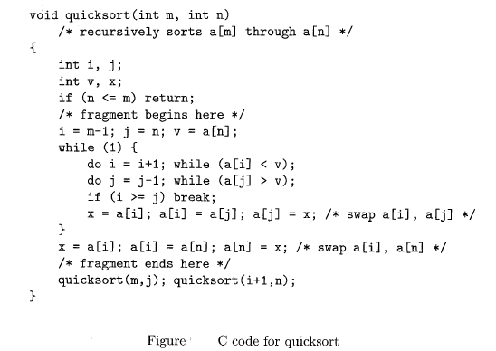
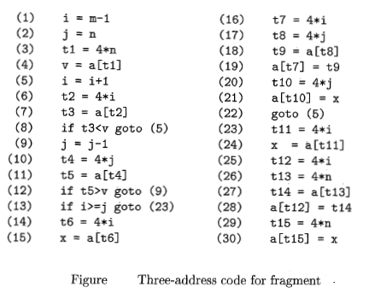

Slide 65
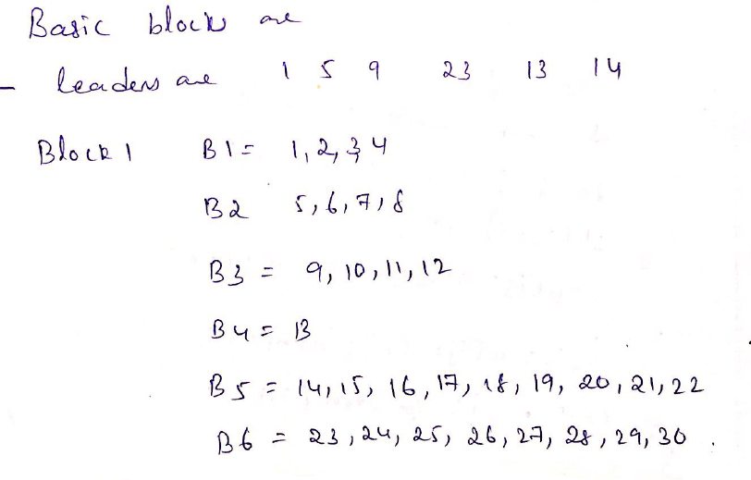

Slide 66
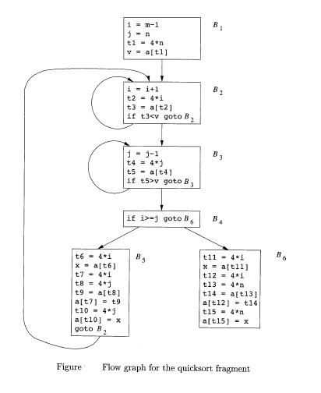

Slide 67
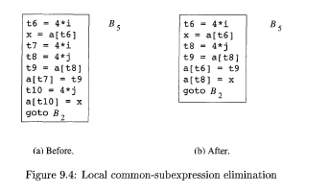
Consider block 5 apply local common sub expression.
Where 3 & 7 calculated values are not using any where t7 & t10. So eliminate.
The assignments to t7 and t10 in Fig. (a) compute the common subexpressions 4 * i and 4 * j, respectively. These steps have been eliminated in Fig. (b), which uses t6 instead of t7 and t8 instead of t10

Slide 68
Apply Global common subexpression:
An occurrence of an expression E is called a common subexpression if E was previously computed and the values of the variables in E have not changed since the previous computation.
We avoid recomputing E if we can use its previously computed value; that is, the variable x to which the previous computation of E was assigned has not changed in the interim

Slide 69
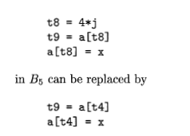
The result of eliminating both global and local
common subexpressions from blocks B5 and B6 in the flow graph of Fig. The transformation of B5 and then mention some subtleties involving arrays. After local common subexpressions are eliminated, B5 still evaluates 4*i and 4 * j, as shown in Fig. (b).

Slide 70
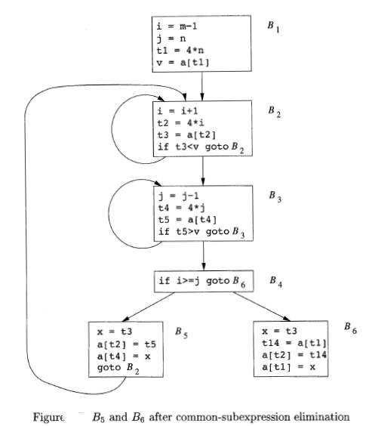

Slide 71
Both are common subexpressions; in particular, the three statements using t4 computed in block B3. In Fig. observe that as control passes from the evaluation of 4 * j in B3 to B5, there is no change to j and no change to t4, so t4 can be used if 4 * j is needed.
Another common subexpression comes to light in B5 after t4 replaces t8. The new expression a[t4] corresponds to the value of a[j] at the source level.
Not only does j retain its value as control leaves B3 and then enters B5, but a[j], a value computed into a temporary t5, does too, because there are no assignments to elements of the array a in the interim.

Slide 72
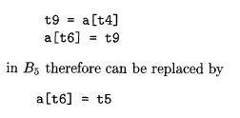
The value assigned to x in block B5 of Fig.(b) is seen to be the same as the value assigned to t3 in block B2. Block B5 in Fig. is the result of eliminating common subexpressions corresponding to the values of the source level expressions a[i] and a[j] from B5 in Fig. (b).
A similar series of transformations has been done to B6 in Fig. The expression a[tl] in blocks B1 and B6 of Fig. is not considered a common subexpression, although tl can be used in both places.
After control leaves B1 and before it reaches B6, it can go through B5, where there are assignments to a. Hence, a[tl] may not have the same value on reaching B6 as it did on leaving B1, and it is not safe to treat a[tl] as a common subexpression

Slide 73
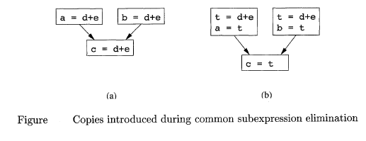
Copy Propagation
Block B5 in Fig. can be further improved by eliminating x, using two new transformations. One concerns assignments of the form u = v called copy statements, or copies for short. would have arisen much sooner, because the normal algorithm for eliminating common subexpressions introduces them, as do several other algorithms

Slide 74
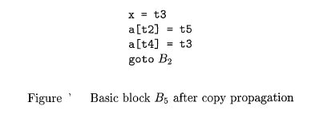
In order to eliminate the common subexpression from the statement c = d+e in Fig. (a), we must use a new variable t to hold the value of d + e. The value of variable t, instead of that of the expression d + e, is assigned to c in Fig. (b).
Since control may reach c = d+e either after the assignment to a or after the assignment to b, it would be incorrect to replace c = d+e by eith
The idea behind the copy-propagation transformation is to use v for u, wherever possible after the copy statement u = v. For example, the assignment x = t3 in block B5 of Fig. is a copy. Copy propagation applied to B5 yields the code in Fig. 9.7. This change may not appear to be an improvement, but, as we shall next it gives us the opportunity to eliminate the assignment to x. er c = a o r by c = b.

Slide 75

Dead-Code Elimination
A variable is live at a point in a program if its value can be used subsequently; otherwise, it is dead at that point. A related idea is dead (or useless) code - statements that compute values that never get used.
While the programmer is unlikely to introduce any dead code intentionally, it may appear as the result of previous transformations.
Copy propagation followed by dead-code elimination removes the assignment to x and transforms the code

Slide 76
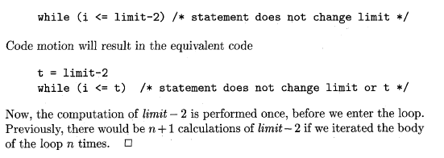
CodeMotion
Loops are a very important place for optimizations, especially the inner loops where programs tend to spend the bulk of their time.
The running time of a program may be improved if we decrease the number of instructions in an inner loop, even if we increase the amount of code outside that loop.

Slide 77
Induction Variables and Reduction in Strength
Loops are usually processed inside out. For example consider the loop around B3.
• Note that the values of j and t4 remain in lock-step; every time the value of j decreases by 1, that of t4 decreases by 4 because 4*j is assigned to t4. Such identifiers are called induction variables. When there are two or more induction variables in a loop, it may be possible to get rid of all but one, by the process of induction-variable elimination. For the inner loop around B3 in Fig. we cannot get rid of either j or t4 completely; t4 is used in B3 and j in B4. However, we can illustrate reduction in strength and illustrate a part of the process of induction-variable elimination. Eventually j will be eliminated when the outer loop of B2 - B5 is considered.
Example:
Reduction in strength replaces expensive operations by equivalent cheaper ones on the target machine. Certain machine instructions are considerably cheaper than others and can often be used as special cases of more expensive operators.
• For example, x² is invariably cheaper to implement as x*x than as a call to an exponentiation routine. Fixed-point multiplication or division by a power of two is cheaper to implement as a shift. Floating-point division by a constant can be implemented as multiplication by a constant, which may be cheaper

Slide 78
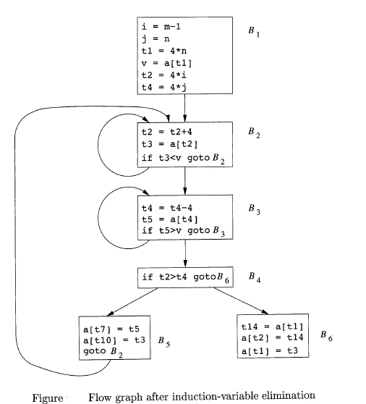

Slide 79
Code optimization
“Code optimization refers to the techniques used by
the compiler to improve the execution efficiency of the generated object code”
It involves a complex analysis of the intermediate code and the performance of various transformations but every optimizing transformation must also preserve the semantics of the program. That is a compiler should not attempt any optimization that would lead to a change in the programs semantics.There are generally two types of optmization.Machine independent and machine dependent.

Slide 80
Machine Independent Optimization
Machine independent optimization or Source level optmization. can be performed independently of the target machine for which the compiler is generating code. that is the optimizations are not tied to the target machines specific platform or language. Examples of machine independent optimizations are: elimination of loop invariant computation, induction variable elimination, and elimination of common sub expressions.

Slide 81
Machine Dependent Optmization
On the other hand, machine dependent optimization or Target level optimization requires knowledge of the target machine, an attempt to generate object code that will utilize the target machines registers more efficiently is an example of machine dependent code optimization. Actually, code optimization is a misnomer even after performing various optimizing transformations there is no guarantee that the generated object code will be optimal. Hence we are actually performing code improvement.

Slide 82
CRITERIA
When attempting any optimizing transformation the following criteria should be applied:
The optimizing should capture most of the potential improvements with out an unreasonable amount of effort.
The optimization should be such that the meaning of the source program is preserved.
The optimization should on average reduce the time and space expended by the object code.

Slide 83
Local vs Global Optimization
A transformation of a program is called local if it can be performed by looking only at the statements in a basic blocks ; other wise ,it is called global .
Many transformations can be performed at both the local and global levels
Local transformations are usually performed first.

Slide 84
Local Optimizations
The simplest form of optimizations are local to a small piece of code.
No need to analyze the whole procedure body, just the basic block (typically just a small portion of one statement) in question
Example: algebraic simplification

Slide 85
Algebraic Simplification
Some statements can be deleted
Some statements can be simplified
x = x + 0
x = x * 1

Slide 86
Algebraic Simplification
x = x * 0 ⇒ x = 0
y = y ^ 2 ⇒ y = y * y
x = x * 8 ⇒ x = x << 3
x = x * 15 ⇒ t = x << 4; x = t - x
x3 ⇒ x*x*x
x * 25 = (x << 4) + (x << 3) + x Where the sum of base 2 powers equals to 25: 2^4+2^3+2^0 = 25
How does x / 25 work out with right shifts?
( on most machines << is much faster than *; but not on all!)

Slide 87
Algebraic Simplification
X + 0 = 0 + x x
X – 0 x
X * 1 = 1 * x x
X / 1 = x

Slide 88
Strength Reductions
Strength reduction means replacing expensive operations with cheaper ones.
Replacing integer multiplication or division by constants with shift operations.
Replacing 32-bit integer division by 64-bit floating point division.
Replacing floating point multiplications by small constants with floating point additions.
Replacing power function by floating point multiplications.

Slide 89
Structure-Preserving Transformations
There are a number of ways in which a compiler can improve a program without changing the function it computes.writen below are the examples of such function preserving transformation.
Common subexpression elimination
Dead code elimination
Copy propagation
Constant folding

Slide 90
Common Subexpression elimination
An occurrence of an expression “E” is called a common subexpression if E was previously computed, and the values of variables in E have not changed since the previous computation. We can avoid recomputing the expression if we can use the previous computed value. For example;

Slide 91
Common subexpression elimination
For example;
a := b + c
b := a - d
c := e + c
d := a - d
a := b + c
b := a - d
c := e + c
d := b

Slide 92
Another example
X = b * c + 4
z = b * c - 1
t = b * c
x = t + 4
z = t - 1

Slide 93
Copy propagation
Given an assignment of the form x = y, replace later uses of x with uses of y (as long as there are no instructions between the assignment and the uses that redefine x or y)

Slide 94
example
x = b + c
z = y * x
x = b + c
z = y * ( b + c)

Slide 95
Dead code elimination
A variable is dead at some point if its value is not used on any path from that point to the exit. An instruction is dead if it computes only values that are not used on any path to the exit. Dead code elimination removes dead instructions.
Dead code often arises from other optimizations.

Slide 96
Example_1
Dead code Elimination is merely the removal of code that is never used.
i=0
If (i!=0) deadcode(i);

Slide 97
Example_2
An other example of unreachable code is a procedure that is never called (or is only called from code that is itself unreachable)
The elimination of unreachable code does not usually affect execution speed significantly ,but it can substantially reduce the size of the target code.

Slide 98
Constant Folding
The evaluation at compile time of expressions whose values are known to be constant.
Many operations on constants can be computed at compile time
In general, if there is a statement
x = y op z
…and y and z are constants (or set to constants)
…then y op z can be computed at compile time

Slide 99
example
Example: x = 2 + 2 ⇒ x = 4

Slide 100
Another example
Constant folding is when expressions with multiple constants are folded together and evaluated at compile time.
a = 1+ 2
Will be replaced by a = 3.
( 100 > 0) true

Slide 101
Procedure inlining
One operation that can sometimes be relatively expensive is procedure call, where many calling sequence operations must be performed. Modern processors have reduced this cost substantially by offering hardware support (by increasing no of register of cpu) for standard calling sequences but the removal of frequent calls to small procedures can still produce measurable speedups.

Slide 102
There is a way to remove procedure calls by replacing procedure call with the code for the procedure body. This is called procedure inlining.

Slide 103
An Example
Initial code:
…
a = x ^ 2
b = 3
c = x
d = c * c
e = b * 2
f = a + d
g = e * f
…

Slide 104
An Example
Algebraic Optimization:
…
a = x ^ 2
b = 3
c = x
d = c * c
e = b * 2
f = a + d
g = e * f
…

Slide 105
An Example
Algebraic Optimization:
…
a = x ^ 2
b = 3
c = x
d = c * c
e = b * 2
f = a + d
g = e * f
…

Slide 106
An Example
Algebraic Optimization:
…
a = x * x
b = 3
c = x
d = c * c
e = b << 1
f = a + d
g = e * f
…

Slide 107
An Example
Copy propagation:
…
a = x * x
b = 3
c = x
d = c * c
e = b << 1
f = a + d
g = e * f
…

Slide 108
An Example
Copy propagation:
…
a = x * x
b = 3
c = x
d = c * c
e = b << 1
f = a + d
g = e * f
…

Slide 109
An Example
Copy propagation:
…
a = x * x
b = 3
c = x
d = c * c
e = 3 << 1
f = a + d
g = e * f
…

Slide 110
An Example
Copy propagation:
…
a = x * x
b = 3
c = x
d = c * c
e = 3 << 1
f = a + d
g = e * f
…

Slide 111
An Example
Copy propagation:
…
a = x * x
b = 3
c = x
d = x * x
e = 3 << 1
f = a + d
g = e * f
…

Slide 112
An Example
Constant folding:
…
a = x * x
b = 3
c = x
d = x * x
e = 3 << 1
f = a + d
g = e * f
…

Slide 113
An Example
Constant folding:
…
a = x * x
b = 3
c = x
d = x * x
e = 3 << 1
f = a + d
g = e * f
…

Slide 114
An Example
Constant folding:
…
a = x * x
b = 3
c = x
d = x * x
e = 6
f = a + d
g = e * f
…

Slide 115
An Example
Common subexpression elimination:
…
a = x * x
b = 3
c = x
d = x * x
e = 6
f = a + d
g = e * f
…

Slide 116
An Example
Common subexpression elimination:
…
a = x * x
b = 3
c = x
d = x * x
e = 6
f = a + d
g = e * f
…

Slide 117
An Example
Common subexpression elimination:
…
a = x * x
b = 3
c = x
d = a
e = 6
f = a + d
g = e * f
…

Slide 118
An Example
Copy propagation (round 2):
…
a = x * x
b = 3
c = x
d = a
e = 6
f = a + d
g = e * f
…

Slide 119
An Example
Copy propagation (round 2):
…
a = x * x
b = 3
c = x
d = a
e = 6
f = a + d
g = e * f
…

Slide 120
An Example
Copy propagation (round 2):
…
a = x * x
b = 3
c = x
d = a
e = 6
f = a + a
g = 6 * f
…

Slide 121
An Example
Dead code elimination:
…
a = x * x
b = 3
c = x
d = a
e = 6
f = a + a
g = 6 * f
…

Slide 122
An Example
Dead code elimination:
…
a = x * x
b = 3
c = x
d = a
e = 6
f = a + a
g = 6 * f
…

Slide 123
An Example
Dead code elimination:
…
a = x * x
f = a + a
g = 6 * f
…

Slide 124
An Example
The final program:
…
a = x * x
f = a + a
g = 6 * f
…

Slide 126
Loop optmization
Loop optimization is the most valuable machine independent optimization especially the inner loops where programs tend to spend the bulk of their time.
The running time of a program may be improved if we decrease the number of instructions in an inner loop, even if we increase the amount of code outside that loop.

Slide 127
Three techniques are important for loop optimization.
Code motion
Induction variable elimination.
Reduction in strength

Slide 128
Code motion(Loop invariant computation)
In code motion we move code outside a loop.
A loop invariant computation is one that computes the same value every time a loop is executed. Therefore ,moving such a computation outside the loop leads to a reduction in the execution time.

Slide 129
To eliminate loop invariant computations ,we identify the invariant computations and then move them outside loop if the move does not lead to a change in the program’s meaning. Identification of loop invariant computation requires the detection of loops in the program. Whether a loop exists in the program or not depends on the program’s control flow ,therefore, requiring a control flow analysis.

Slide 130
For loop detection, a graphical representation, called a “ program flow graph” shows how the control is flowing in the program and how the control is being used.

Slide 131
Example
Move loop invariant computation out side the loops
While ( i < 100) t = x / y
{ while ( i < 100)
*p = x / y + I {
*p = t + 1
i = i + 1 i = i + 1
} }

Slide 132
Another example
while ( i <= limit – 2) /*statement does not change limit */
t= limit – 2
while( i < = t) /*statement does not change limit */

Slide 133
Reduction in strength
It means which replaces an expensive operation by a cheaper one, such as multiplication by addition subtractions .Because multiplication takes more times as compare to addition or subtraction process in many machines.

Slide 134
example
a = b * 17 a = ( b << 4) + b

Slide 135
Induction variable
Typical loop optimization strategies focus on identifying variables that are incremented by fixed amounts with each iteration called induction variable. These include loop control variables and other variables that depend on the loop control variables in a fixed ways
OR

Slide 136
We define basic induction variables of a loop as those names whose only assignments within the loop are of the form i = i ± c , where c is a constant or a name whose value does not change within the loop ,

Slide 138
Loop unrolling
Loop unrolling involves replicating the body of the loop to reduce the required number of tests if the number of iterations are constant. For example consider the following loop;

Slide 139
I = 1
while( I < = 100)
{
x [ I ] = 0;
I ++;
}

Slide 140
In this case , the test I < = 100 will be performed 100 times. But if the body of the loop is replicated, then the number of times this test will need to be performed 50. After replication of the body, the loop will be:

Slide 141
I = 1
while( I < = 100)
{
x [ I ] = 0;
I ++;
x [ I ] = 0;
I ++;
}

Slide 142
It is possible to choose any divisor for the number of times the loop is executed, and the body will be replicated that many times. Unrolling once that is replicating the body to form two copies of the body saves 50% of the maximum possible executions

Slide 143
Loop jamming
Loop jamming is a technique that merges the bodies of two loops if the two loops have the same number of iterations and they use the same indices. This eliminates the test of one loop. For example, consider the following loop

Slide 144
{
for ( I = 0 ; I < 10 ; I ++ )
for ( j = 0 ; j < 10 ; j++ )
x [ I , j ] = 0;
for ( I = 0 ; I < 10 ; I ++ )
x [ I , I ] = 1;
}

Slide 145
Here, the bodies of the loops on I can be concatenated . the result of loop jamming will be:

Slide 146
{
for ( I = 0 ; I < 10 ; I ++ )
{
for ( j = 0 ; j < 10 ; j++ )
x [ I , j ] = 0;
} x [ I , I ] = 1;
}

Slide 147
Lets Optimize...
int sumcalc(int a, int b, int N)
{
int i, x, y;
x = 0;
y = 0;
for(i = 0; i <= N; i++) {
x = x + (4*a/b)*i + (i+1)*(i+1);
x = x + b*y;
}
return x;
}

Slide 148
Constant Propagation
int i, x, y;
x = 0;
y = 0;
for(i = 0; i <= N; i++) {
x = x + (4*a/b)*i + (i+1)*(i+1);
x = x + b*y;
}
return x;

Slide 149
Constant Propagation
int i, x, y;
x = 0;
y = 0;
for(i = 0; i <= N; i++) {
x = x + (4*a/b)*i + (i+1)*(i+1);
x = x + b*y;
}
return x;

Slide 150
Constant Propagation
int i, x, y;
x = 0;
y = 0;
for(i = 0; i <= N; i++) {
x = x + (4*a/b)*i + (i+1)*(i+1);
x = x + b*0;
}
return x;

Slide 151
Algebraic Simplification
int i, x, y;
x = 0;
y = 0;
for(i = 0; i <= N; i++) {
x = x + (4*a/b)*i + (i+1)*(i+1);
x = x + b*0;
}
return x;

Slide 152
Algebraic Simplification
int i, x, y;
x = 0;
y = 0;
for(i = 0; i <= N; i++) {
x = x + (4*a/b)*i + (i+1)*(i+1);
x = x + b*0;
}
return x;

Slide 153
Algebraic Simplification
int i, x, y;
x = 0;
y = 0;
for(i = 0; i <= N; i++) {
x = x + (4*a/b)*i + (i+1)*(i+1);
x = x;
}
return x;

Slide 154
Copy Propagation
int i, x, y;
x = 0;
y = 0;
for(i = 0; i <= N; i++) {
x = x + (4*a/b)*i + (i+1)*(i+1);
x = x;
}
return x;

Slide 155
Copy Propagation
int i, x, y;
x = 0;
y = 0;
for(i = 0; i <= N; i++) {
x = x + (4*a/b)*i + (i+1)*(i+1);
x = x;
}
return x;

Slide 156
Copy Propagation
int i, x, y;
x = 0;
y = 0;
for(i = 0; i <= N; i++) {
x = x + (4*a/b)*i + (i+1)*(i+1);
}
return x;

Slide 157
Common Subexpression Elimination
int i, x, y;
x = 0;
y = 0;
for(i = 0; i <= N; i++) {
x = x + (4*a/b)*i + (i+1)*(i+1);
}
return x;

Slide 158
Common Subexpression Elimination
int i, x, y;
x = 0;
y = 0;
for(i = 0; i <= N; i++) {
x = x + (4*a/b)*i + (i+1)*(i+1);
}
return x;

Slide 159
Common Subexpression Elimination
int i, x, y, t;
x = 0;
y = 0;
for(i = 0; i <= N; i++) {
t = i+1;
x = x + (4*a/b)*i + t*t;
}
return x;

Slide 160
Dead Code Elimination
int i, x, y, t;
x = 0;
y = 0;
for(i = 0; i <= N; i++) {
t = i+1;
x = x + (4*a/b)*i + t*t;
}
return x;

Slide 161
Dead Code Elimination
int i, x, y, t;
x = 0;
y = 0;
for(i = 0; i <= N; i++) {
t = i+1;
x = x + (4*a/b)*i + t*t;
}
return x;

Slide 162
Dead Code Elimination
int i, x, t;
x = 0;
for(i = 0; i <= N; i++) {
t = i+1;
x = x + (4*a/b)*i + t*t;
}
return x;

Slide 163
Loop Invariant Removal
int i, x, t;
x = 0;
for(i = 0; i <= N; i++) {
t = i+1;
x = x + (4*a/b)*i + t*t;
}
return x;

Slide 164
Loop Invariant Removal
int i, x, t;
x = 0;
for(i = 0; i <= N; i++) {
t = i+1;
x = x + (4*a/b)*i + t*t;
}
return x;

Slide 165
Loop Invariant Removal
int i, x, t, u;
x = 0;
u = (4*a/b);
for(i = 0; i <= N; i++) {
t = i+1;
x = x + u*i + t*t;
}
return x;

Slide 166
Strength Reduction
int i, x, t, u;
x = 0;
u = (4*a/b);
for(i = 0; i <= N; i++) {
t = i+1;
x = x + u*i + t*t;
}
return x;

Slide 167
Strength Reduction
int i, x, t, u;
x = 0;
u = (4*a/b);
for(i = 0; i <= N; i++) {
t = i+1;
x = x + u*i + t*t;
}
return x;

Slide 168
Strength Reduction
int i, x, t, u, v;
x = 0;
u = ((a<<2)/b);
for(i = 0; i <= N; i++) {
t = i+1;
x = x + U*i + t*t;
}
return x;

